Slide 2
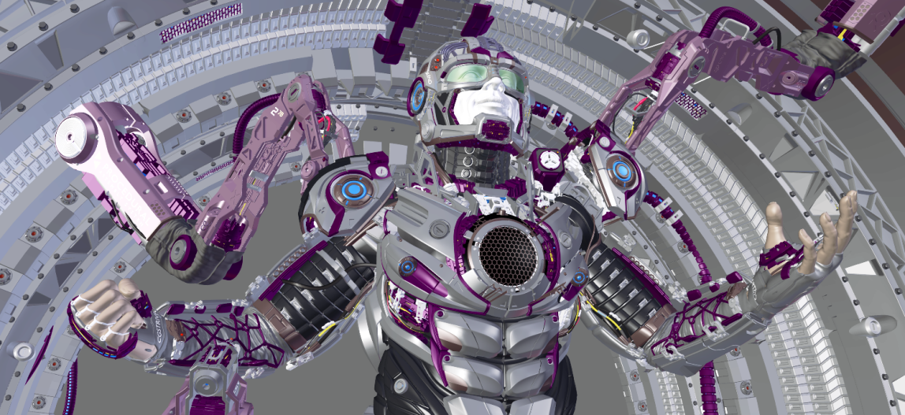

Source: Juri Unt (Artist), Zichen Liu (Renderer), airenderer.com

Slide 3
Spec
Ray tracer
Noisy Image
Ray tracer
Clean Image
Approx. 1 min
Approx. 1 hour

Slide 4
Ours
Approx. 2 mins
Spec
Ray tracer
Noisy Image
Ray tracer
Clean Image
Approx. 1 min
Approx. 1 hour

Slide 5
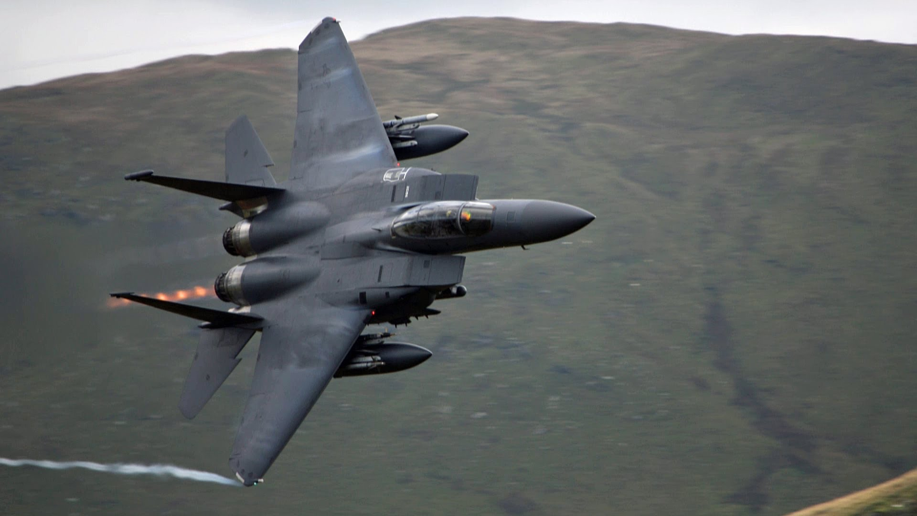
Source: Wonkabar007, youtube.com

Slide 6
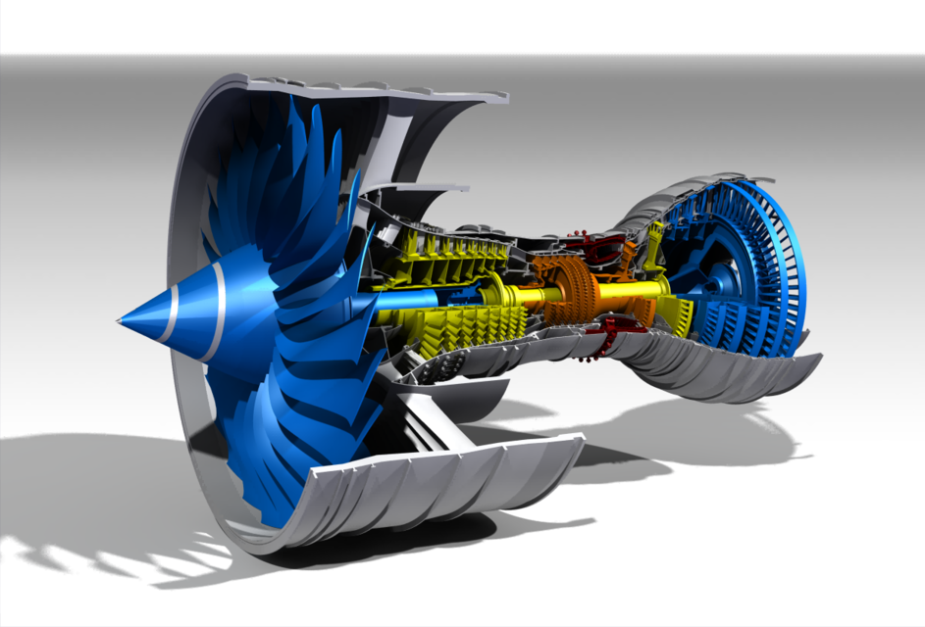
Source: grabcad.com

Slide 7
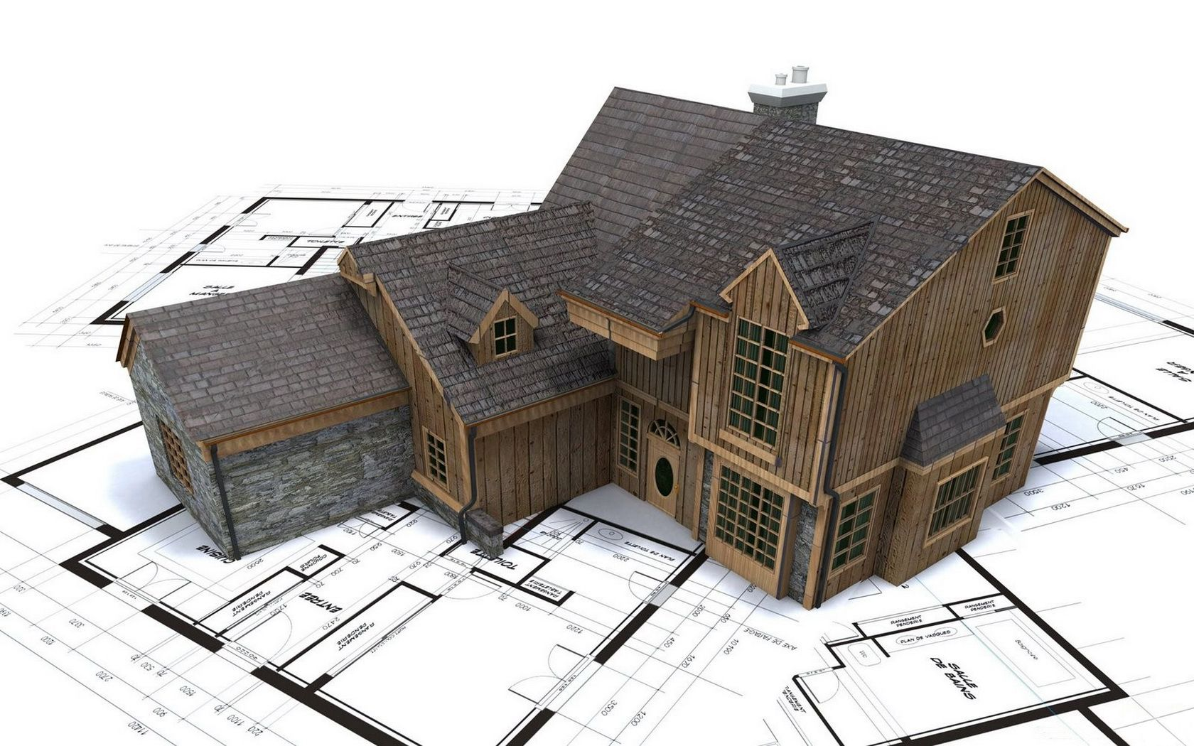
Source: wallpaperup.com

Slide 8
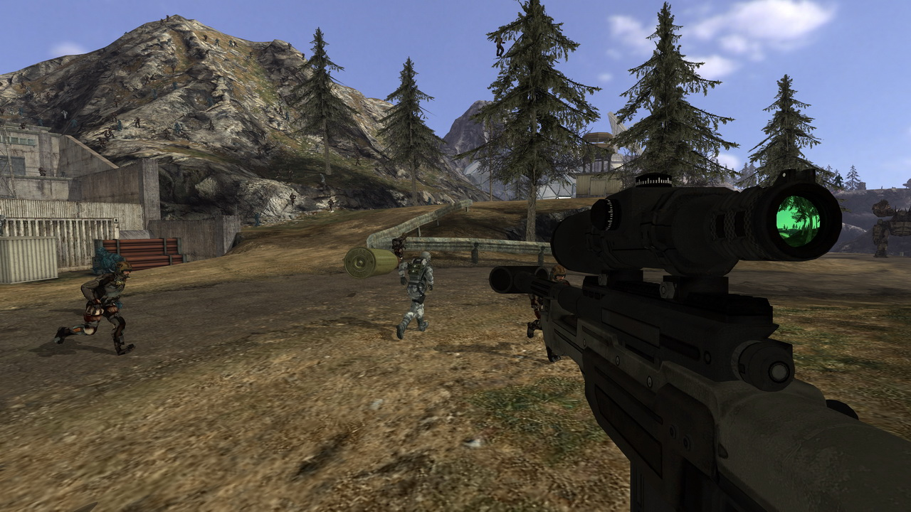
Source: Quake Wars: Ray Traced, Wikipedia

Slide 9
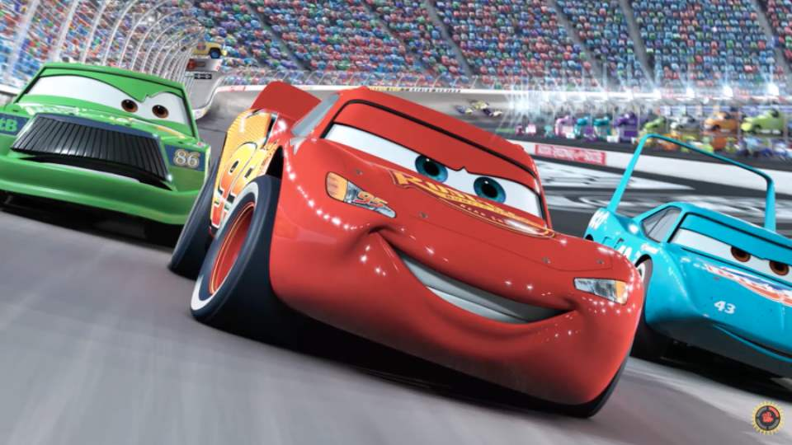
Source: Cars, Pixar, Wikipedia

Slide 10
Source: Quake Wars: Ray Traced, Wikipedia

Slide 11
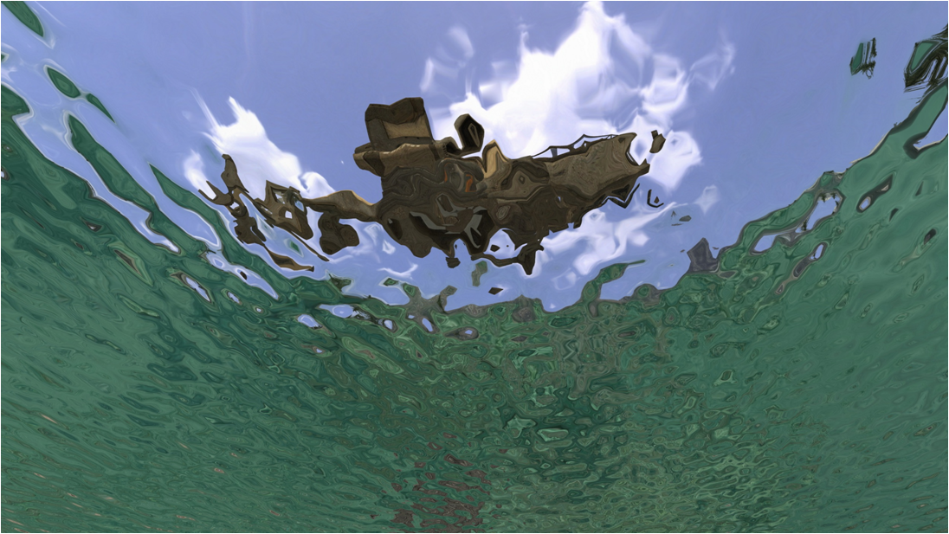
Source: Quake Wars: Ray Traced, Wikipedia

Slide 12
Source: Cars, Pixar, Wikipedia

Slide 13
Source: Cars, Pixar, Wikipedia

Slide 14
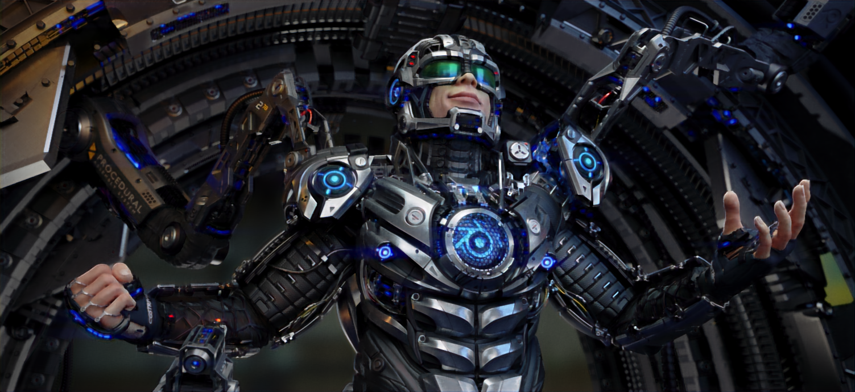
Source: Juri Unt (Artist), Zichen Liu (Renderer), airenderer.com

Slide 15
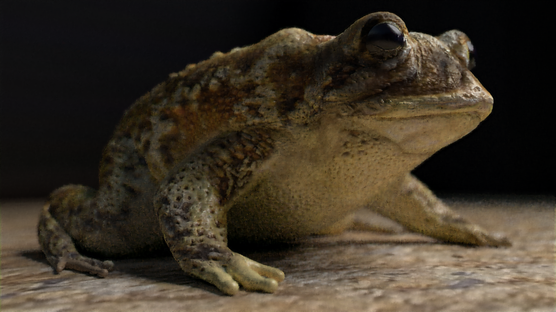
Source: arenyart (Artist), Zichen Liu (Renderer), airenderer.com

Slide 16
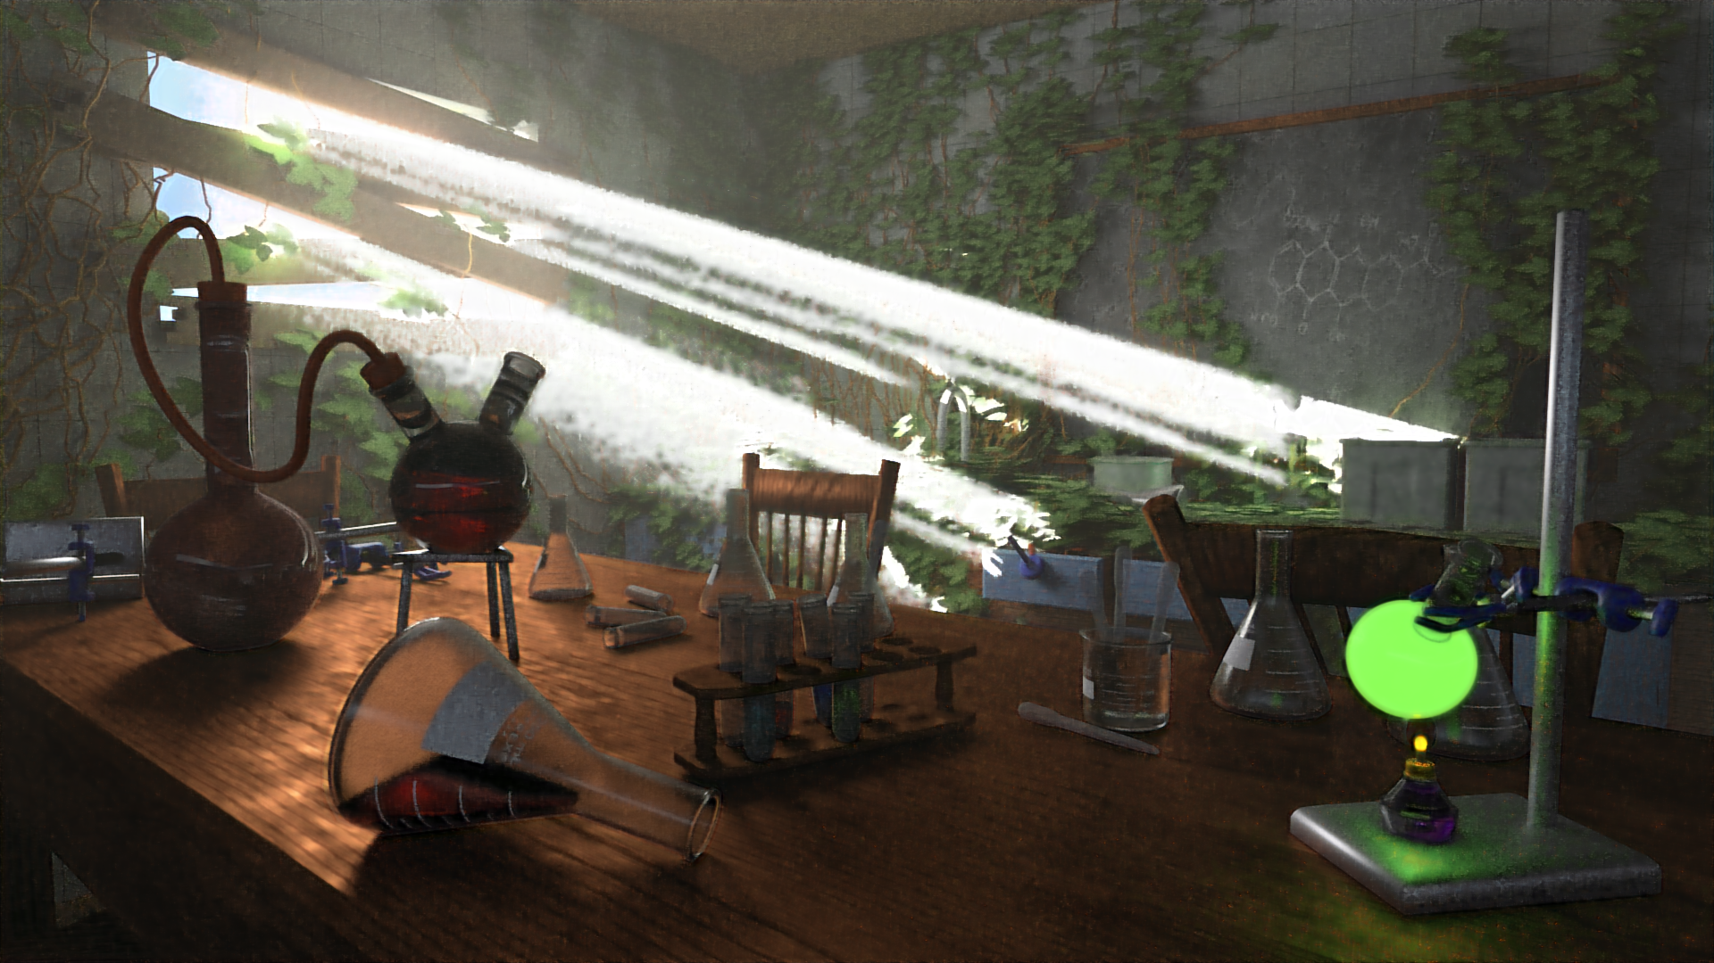
Source: Elysia (Artist), Zichen Liu (Renderer), airenderer.com

Slide 17
Ours
Spec
Ray tracer
Noisy Image
Ray tracer
Clean Image
Approx. 1 min

Slide 18
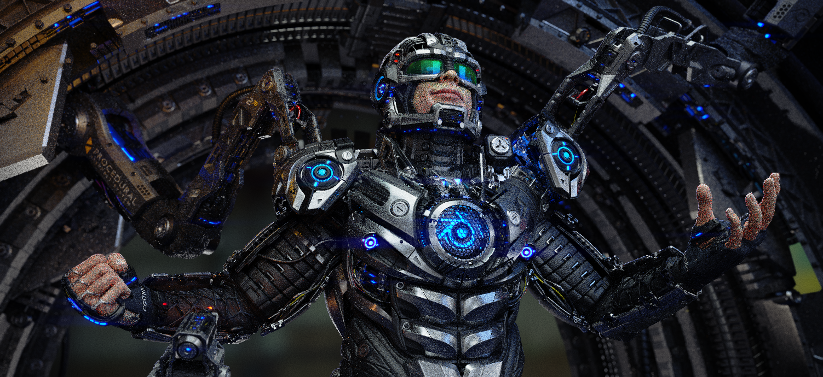
Source: Juri Unt (Artist), Zichen Liu (Renderer)

Slide 19
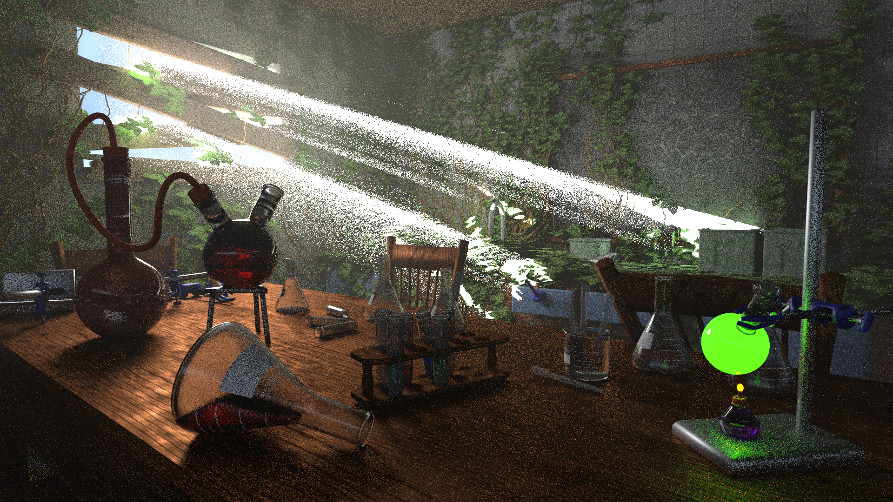
Source: Elysia (Artist), Zichen Liu (Renderer)

Slide 20
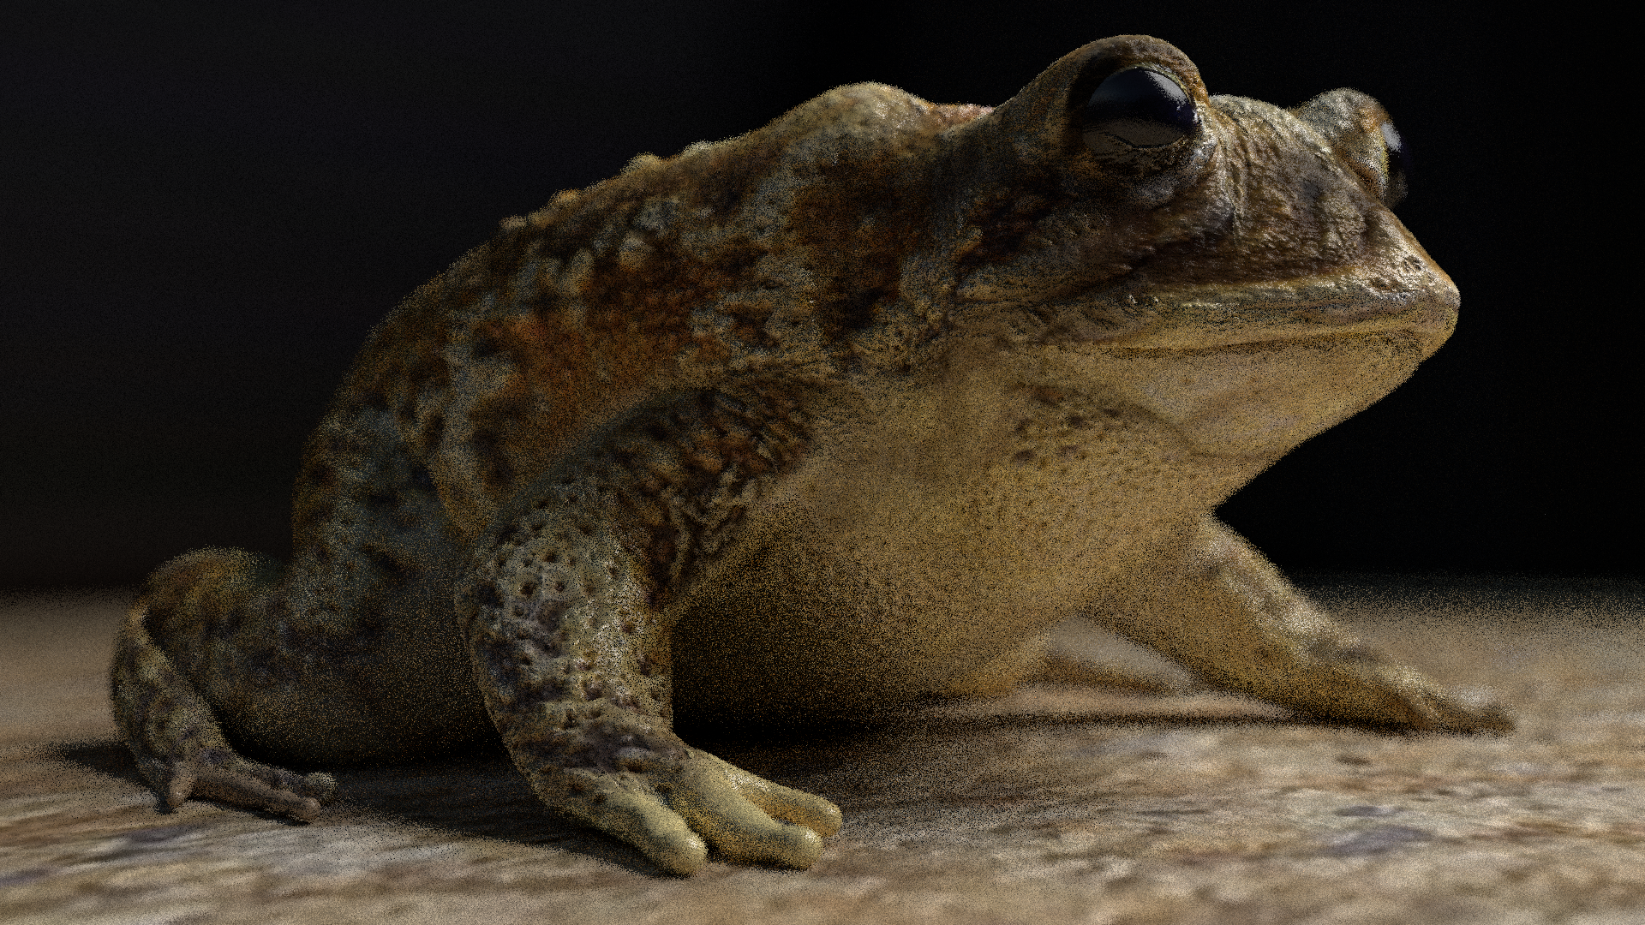
Source: arenyart (Artist), Zichen Liu (Renderer)

Slide 21
Source: Juri Unt (Artist), Zichen Liu (Renderer), airenderer.com

Slide 22
Noisy
Ours
Source: Juri Unt (Artist), Zichen Liu (Renderer)

Slide 23

Ray traced
Ours
Source: Juri Unt (Artist), Zichen Liu (Renderer)

Slide 24
Ours
Spec
Ray tracer
Noisy Image
Ray tracer
Clean Image
Ray tracer
40 minutes
Ours
2 minutes

Slide 25
Source: arenyart (Artist), Zichen Liu (Renderer), airenderer.com

Slide 26
Source: arenyart (Artist), Zichen Liu (Renderer)

Slide 27
Ours
Spec
Ray tracer
Noisy Image
Ray tracer
Clean Image
Ray tracer
14 minutes
Ours
2 minutes

Slide 28
Source: Elysia (Artist), Zichen Liu (Renderer), airenderer.com

Slide 29
Source: Elysia (Artist), Zichen Liu (Renderer)

Slide 30
Ours
Spec
Ray tracer
Noisy Image
Ray tracer
Clean Image
Ray tracer
120 + ? minutes
Ours
2 minutes

Slide 31
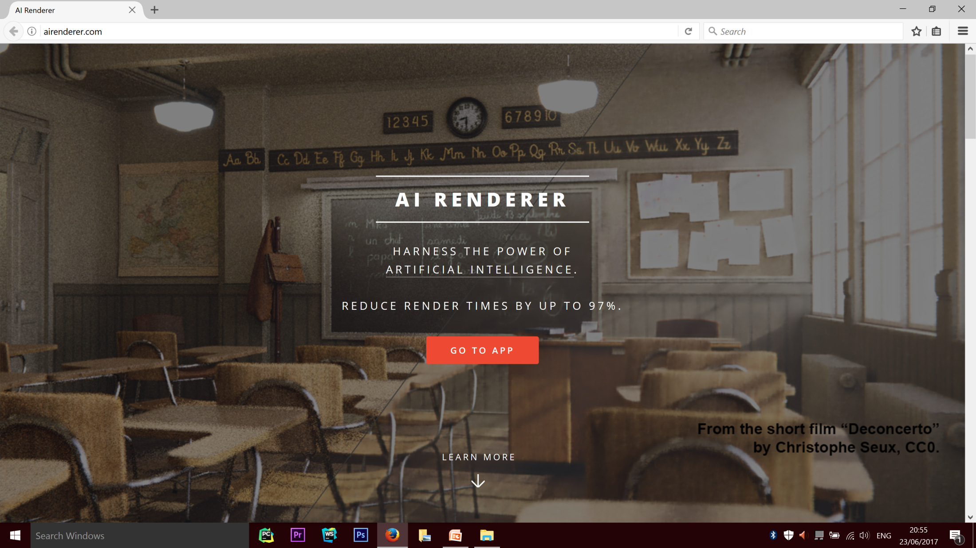

Slide 32
1000+
Visits

Slide 33
108
app uses

Slide 34
26
ratings left

Slide 35
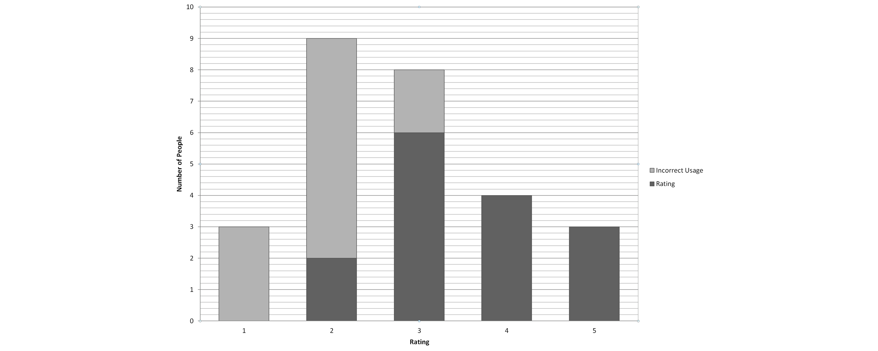

Slide 37
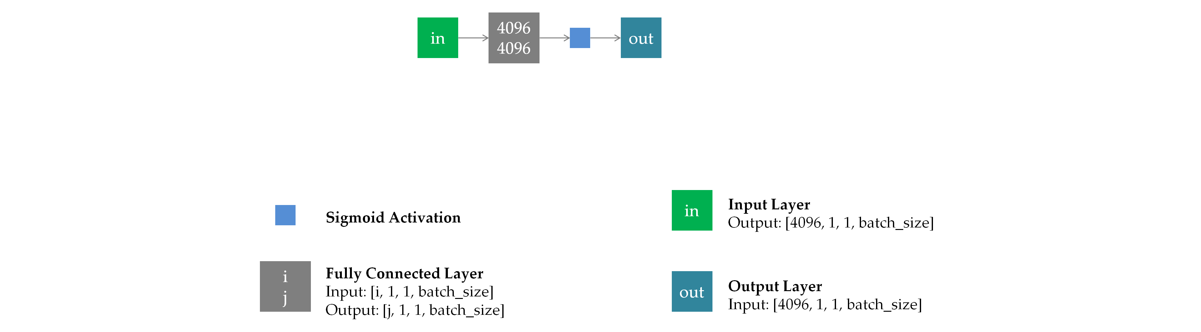

Slide 38
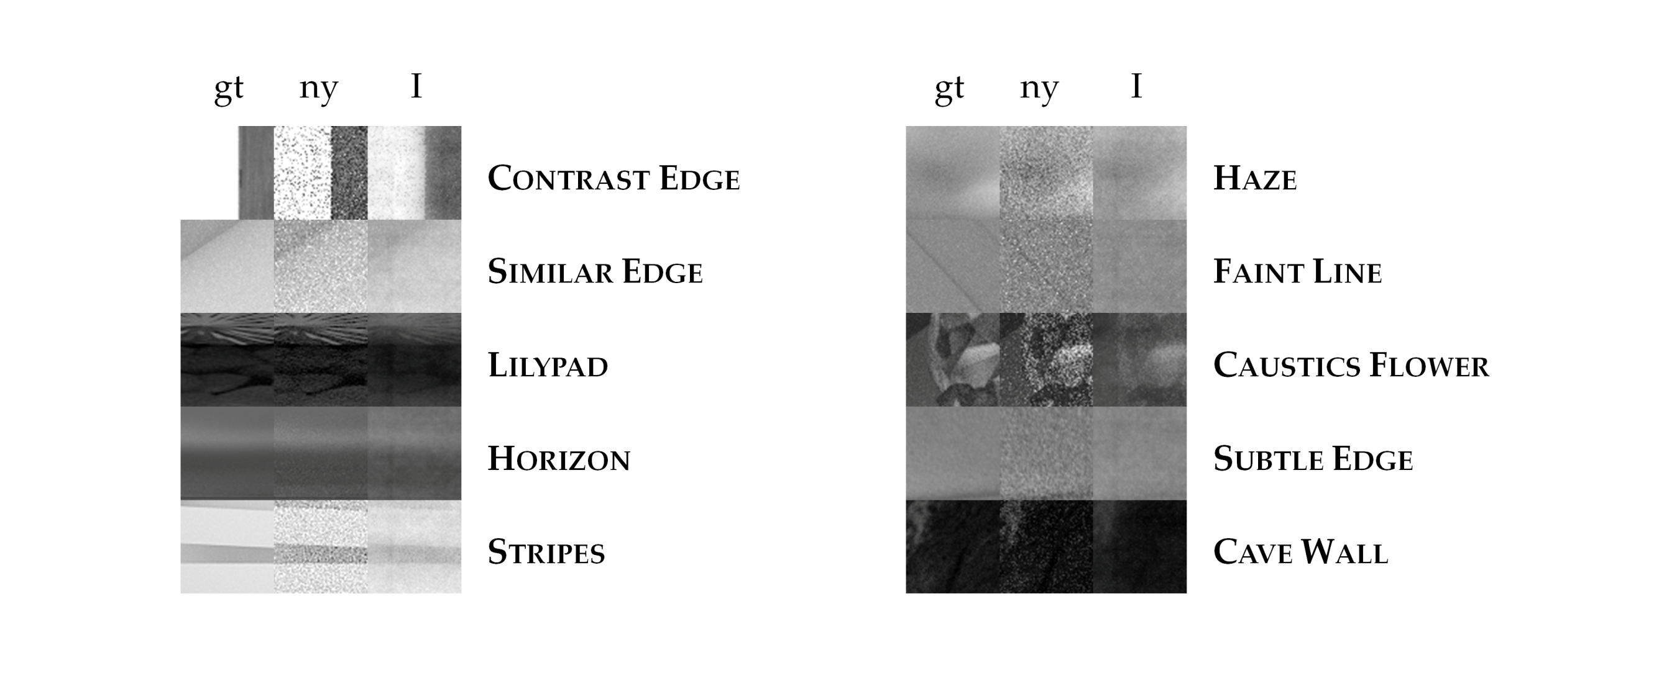

Slide 39
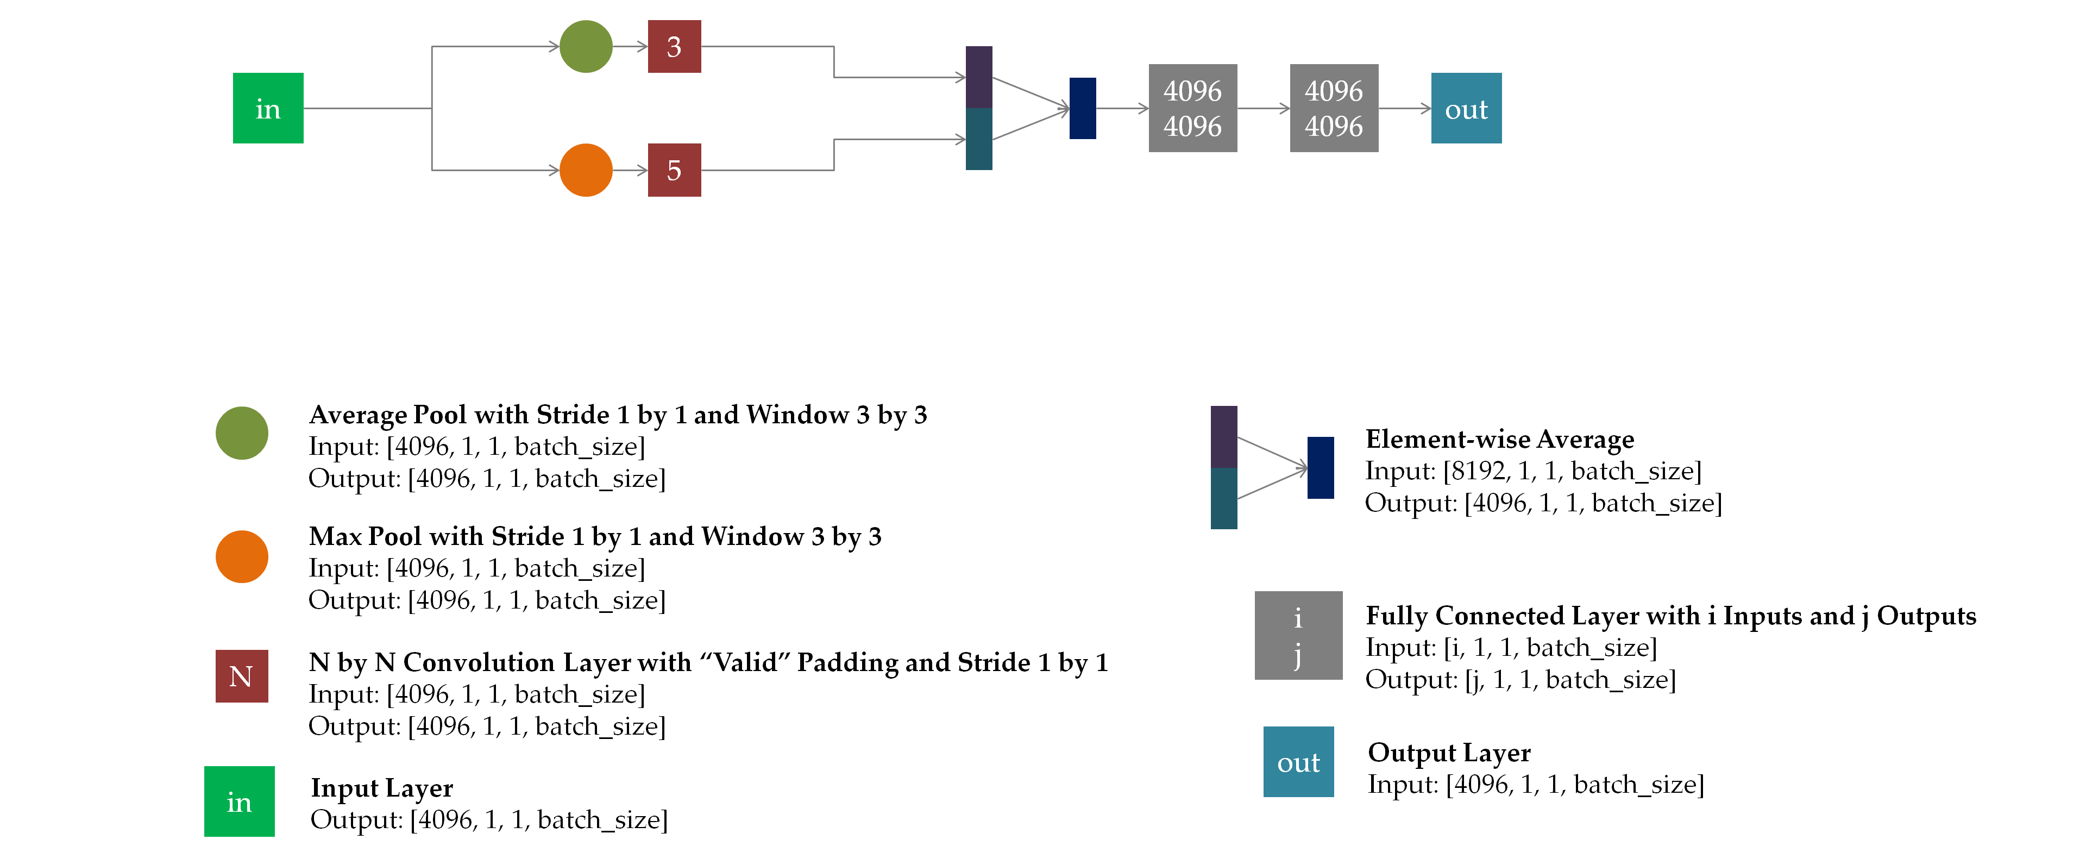

Slide 40
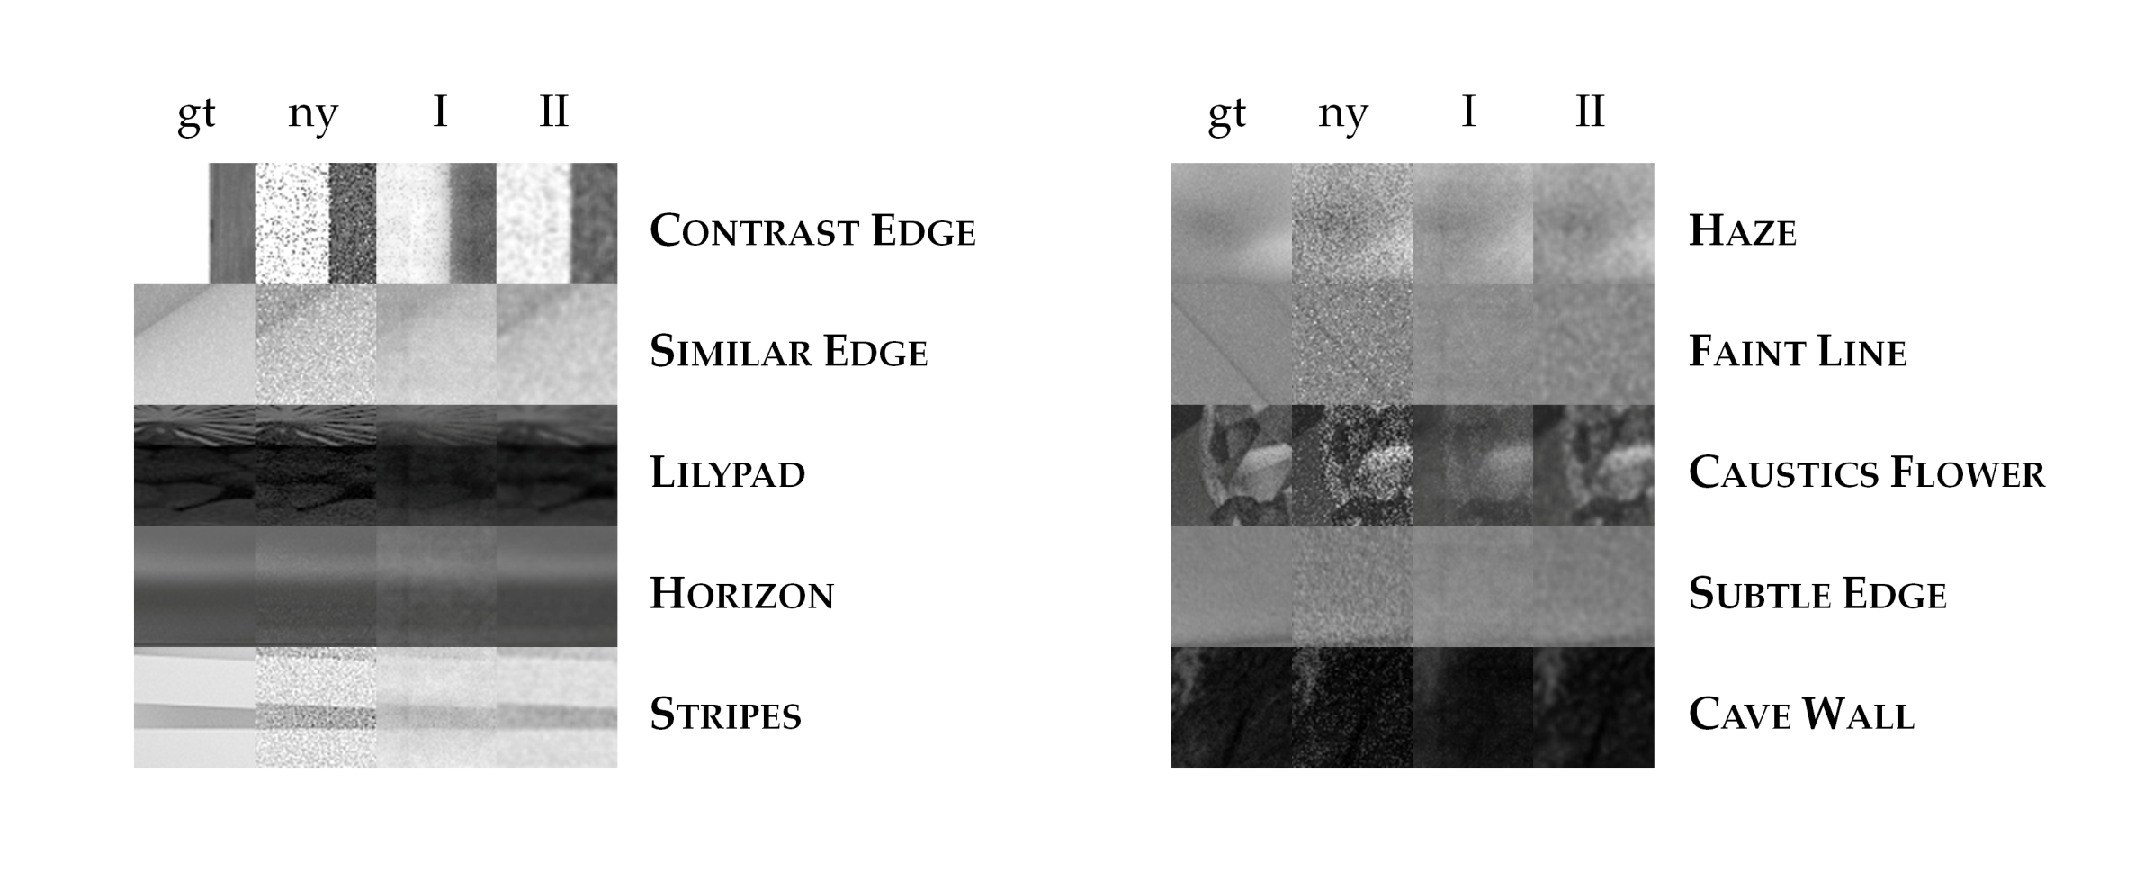

Slide 41
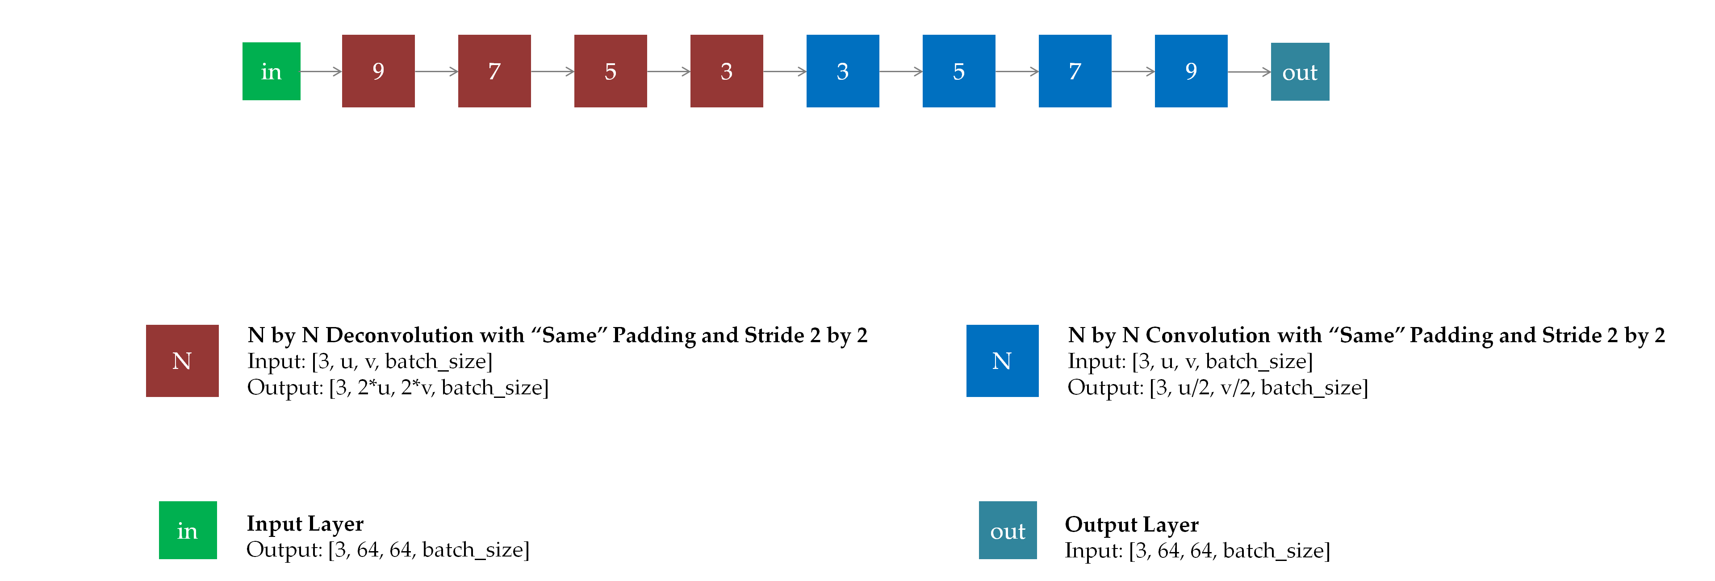

Slide 42
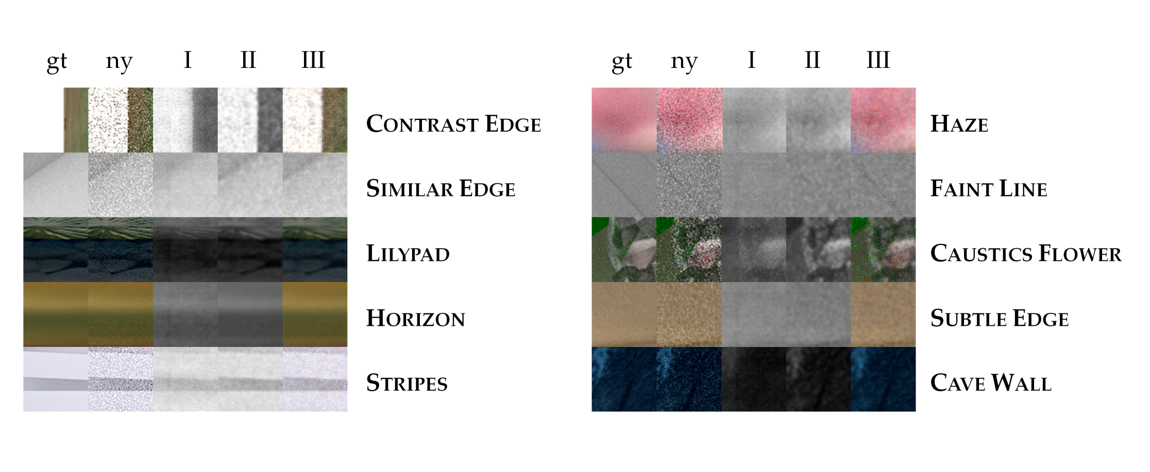

Slide 43
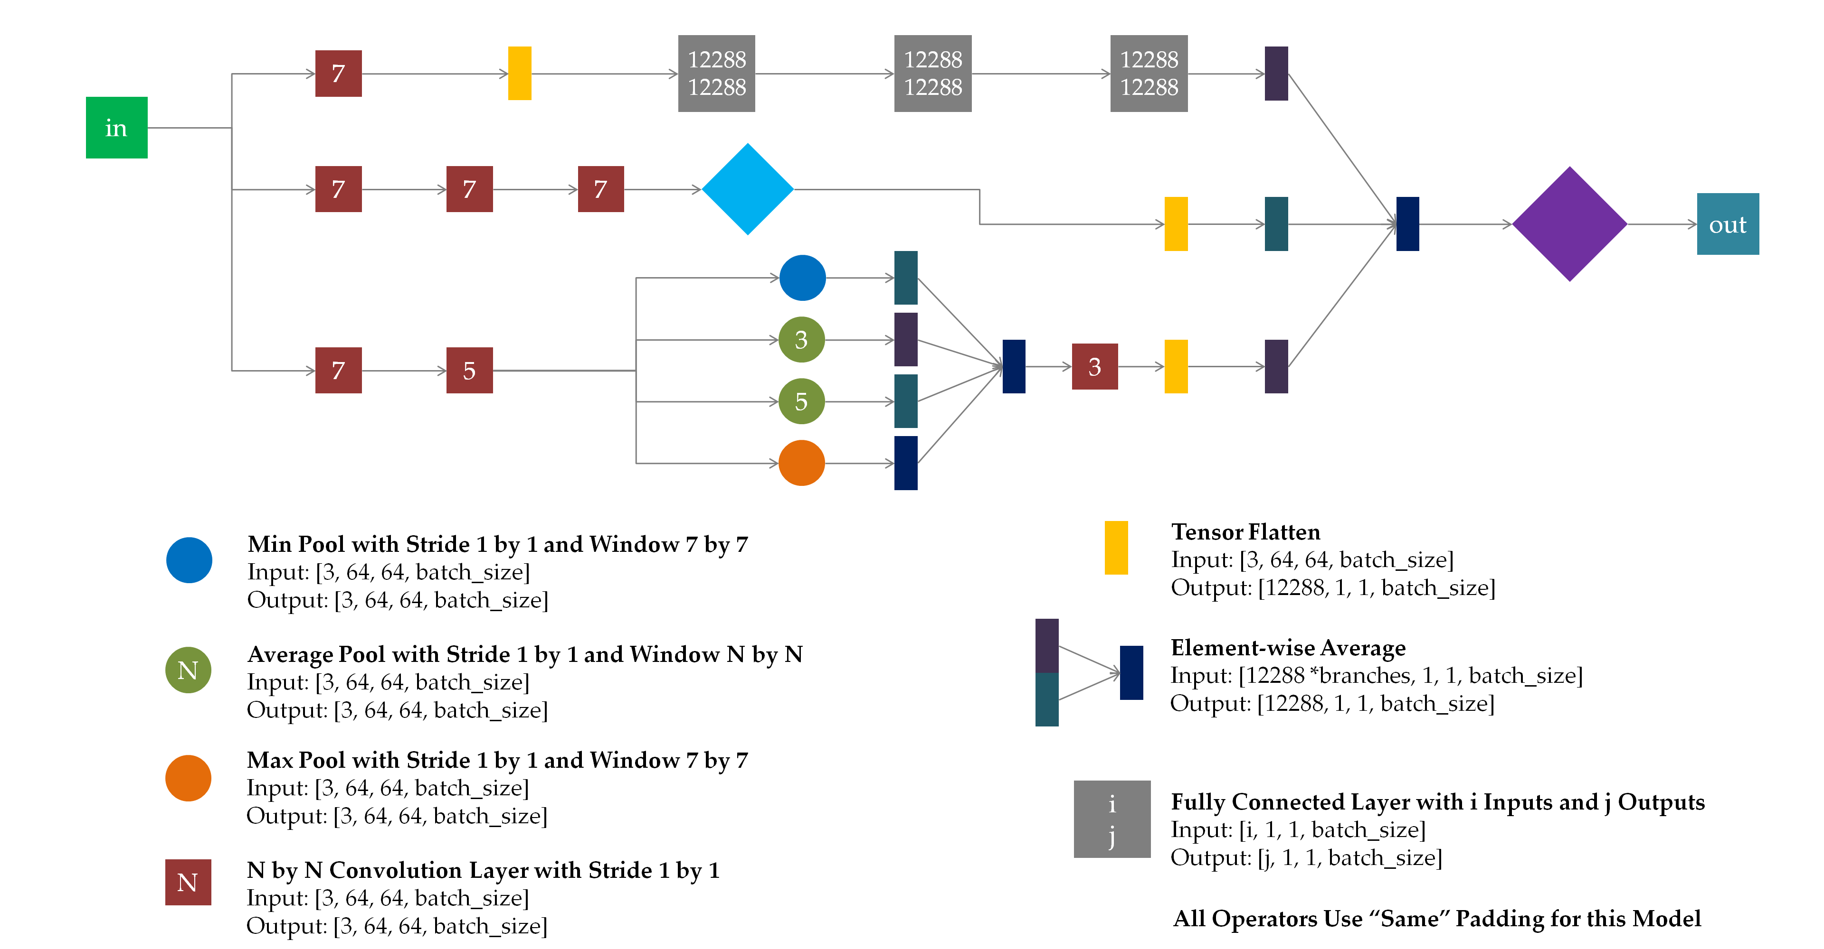

Slide 44
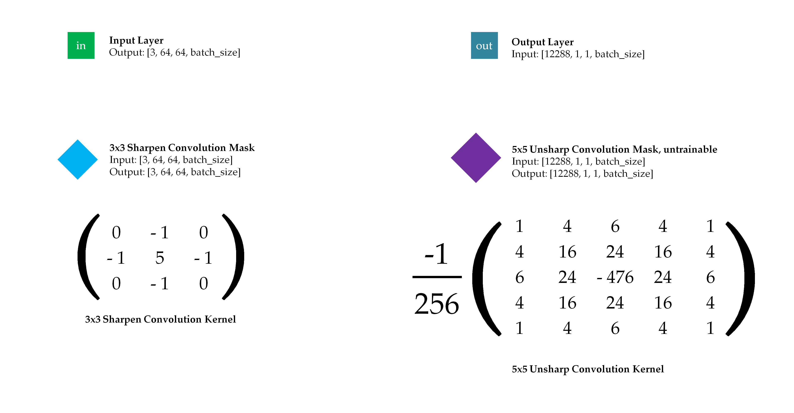

Slide 45
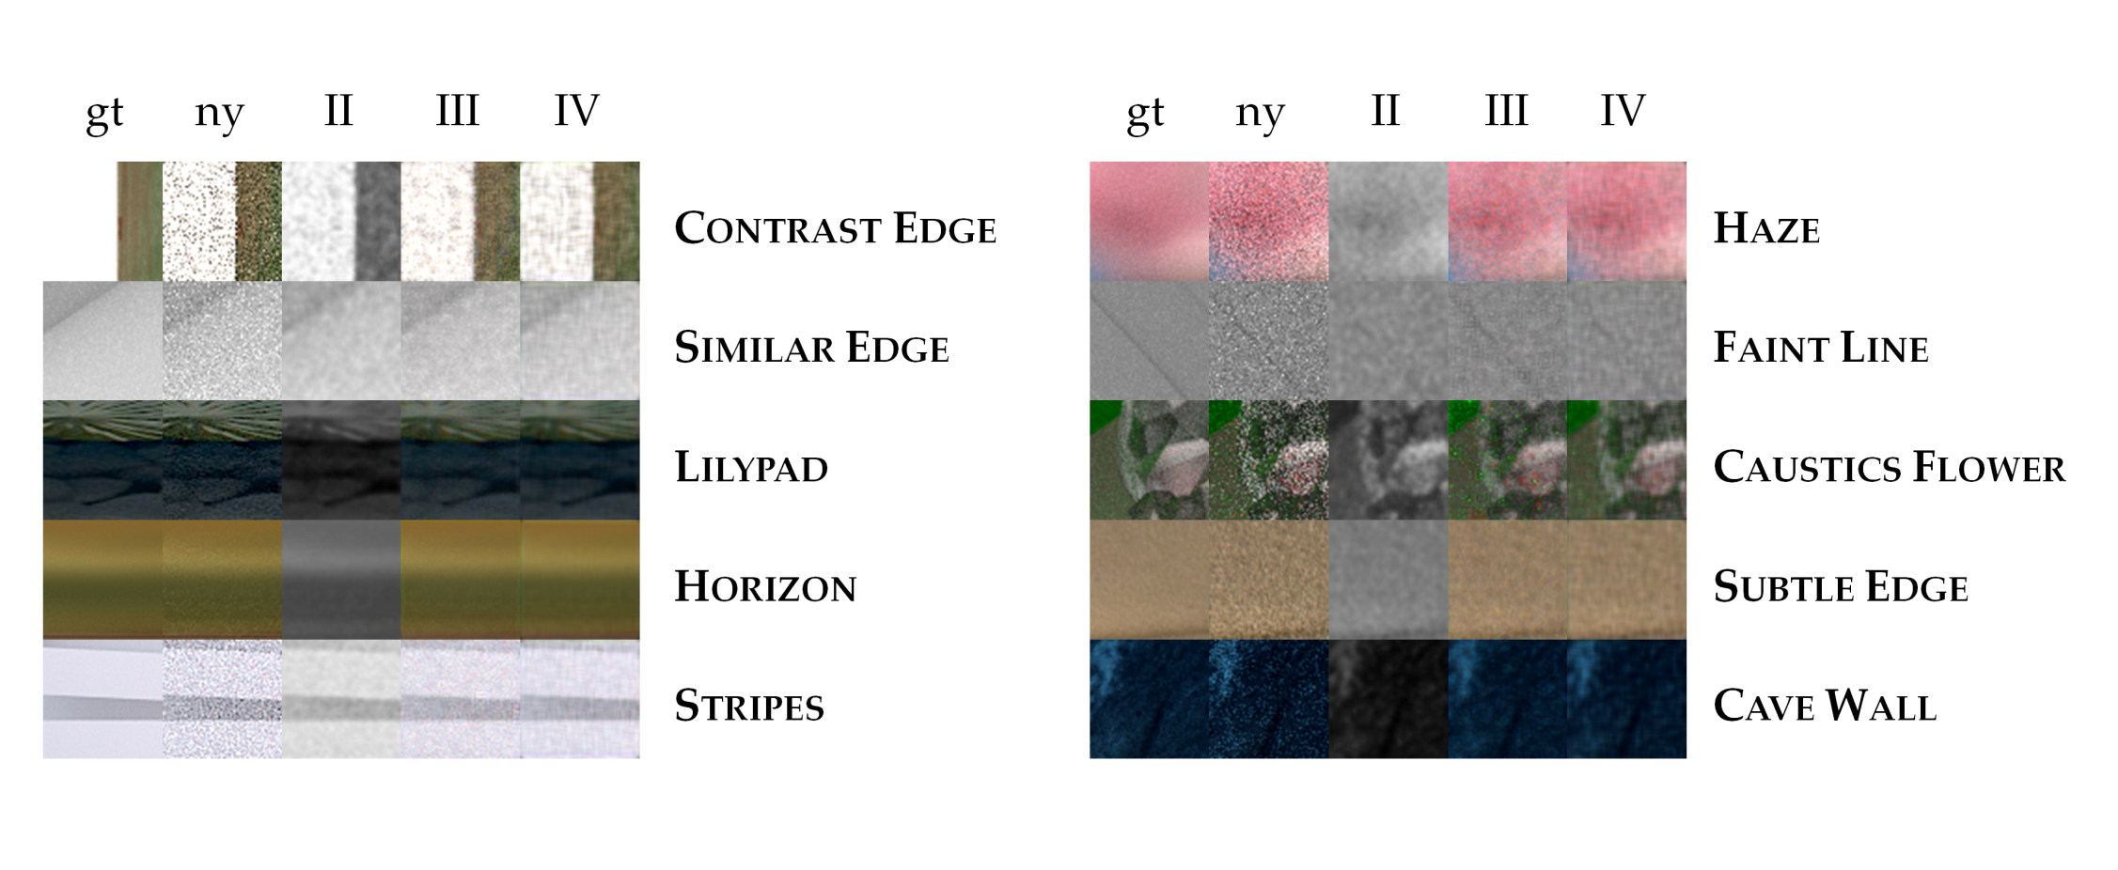

Slide 46
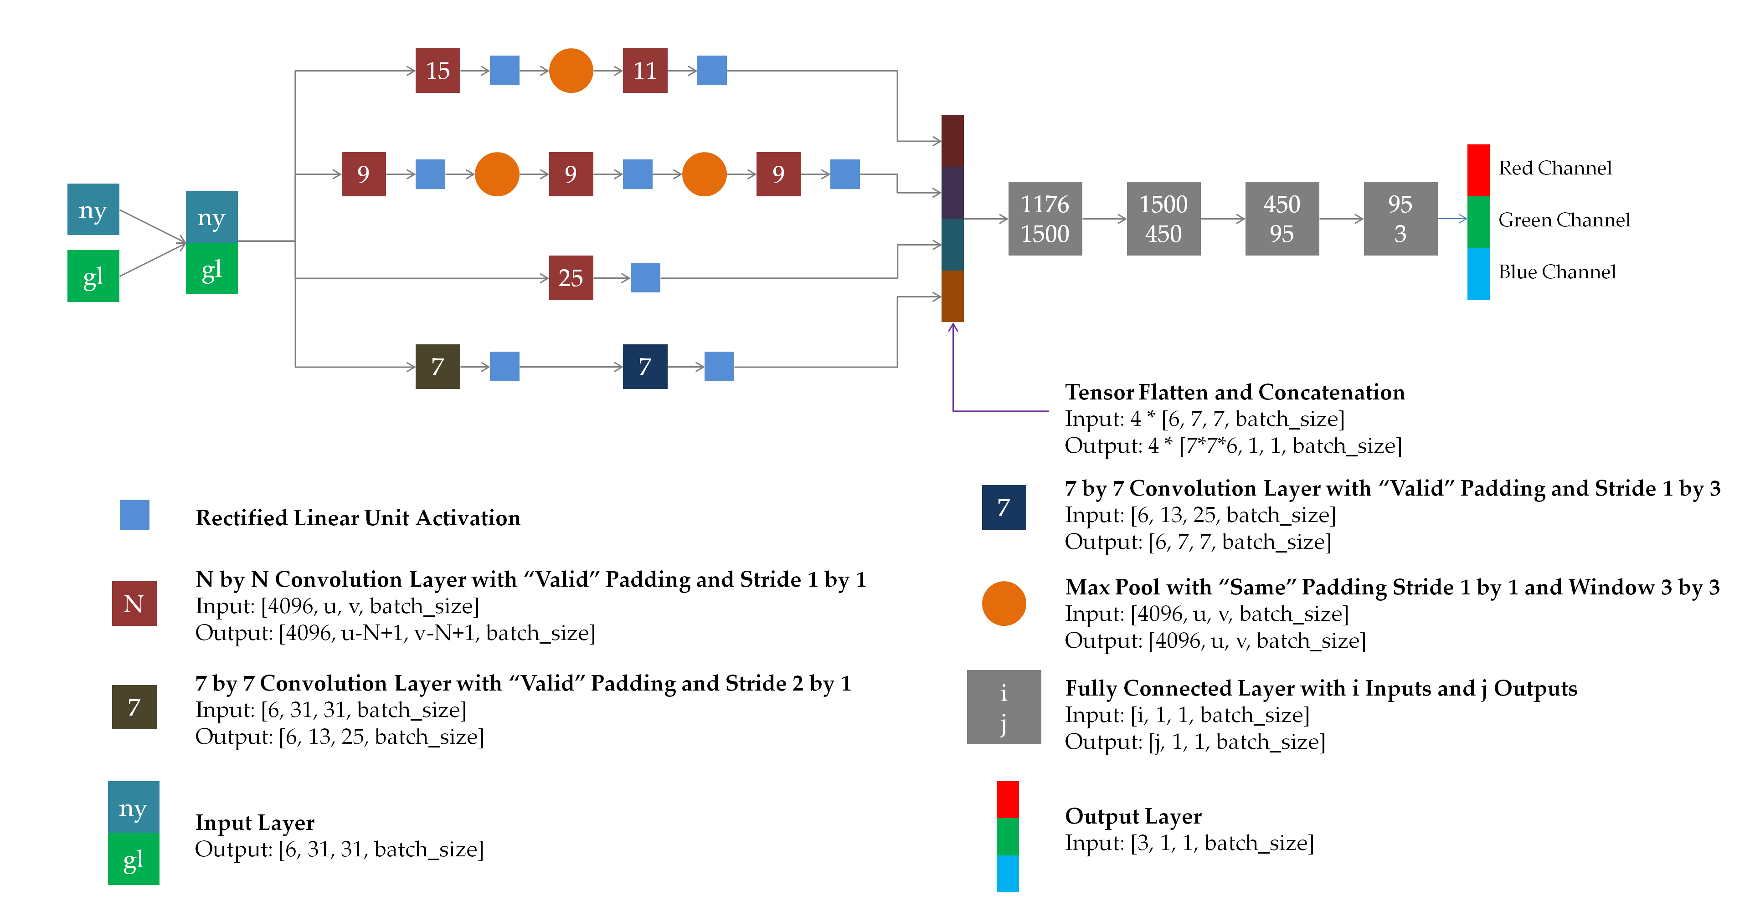

Slide 47
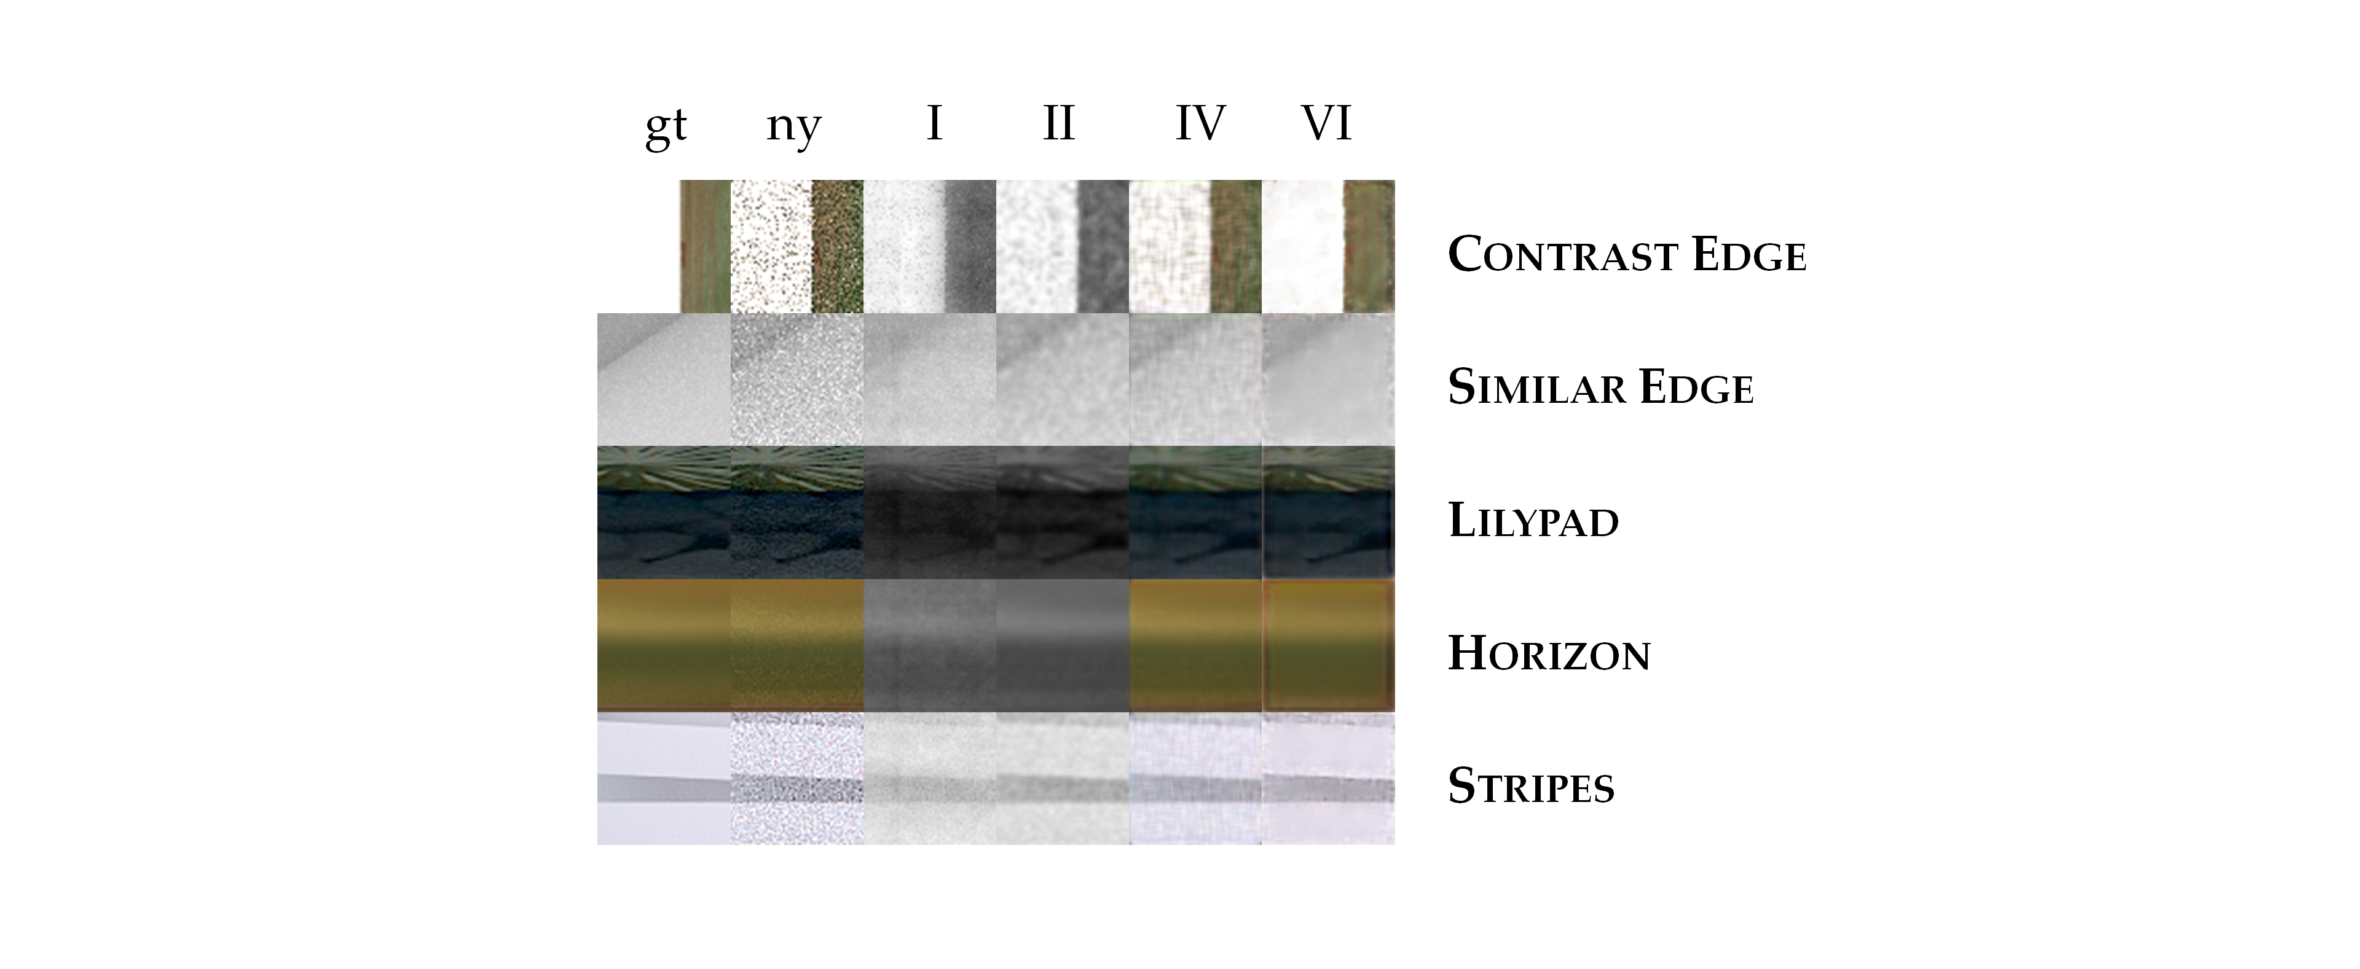

Slide 48
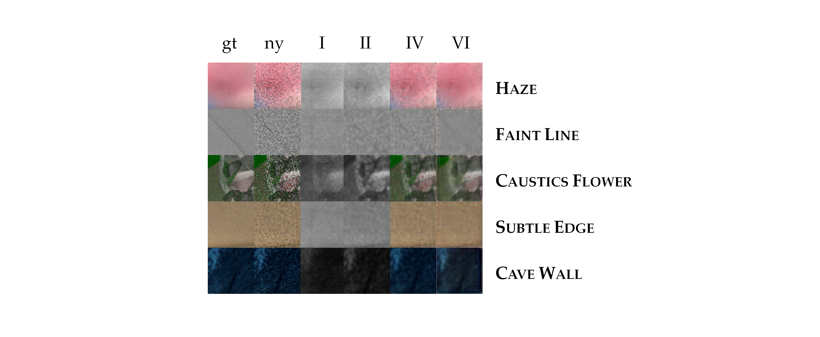

Slide 49
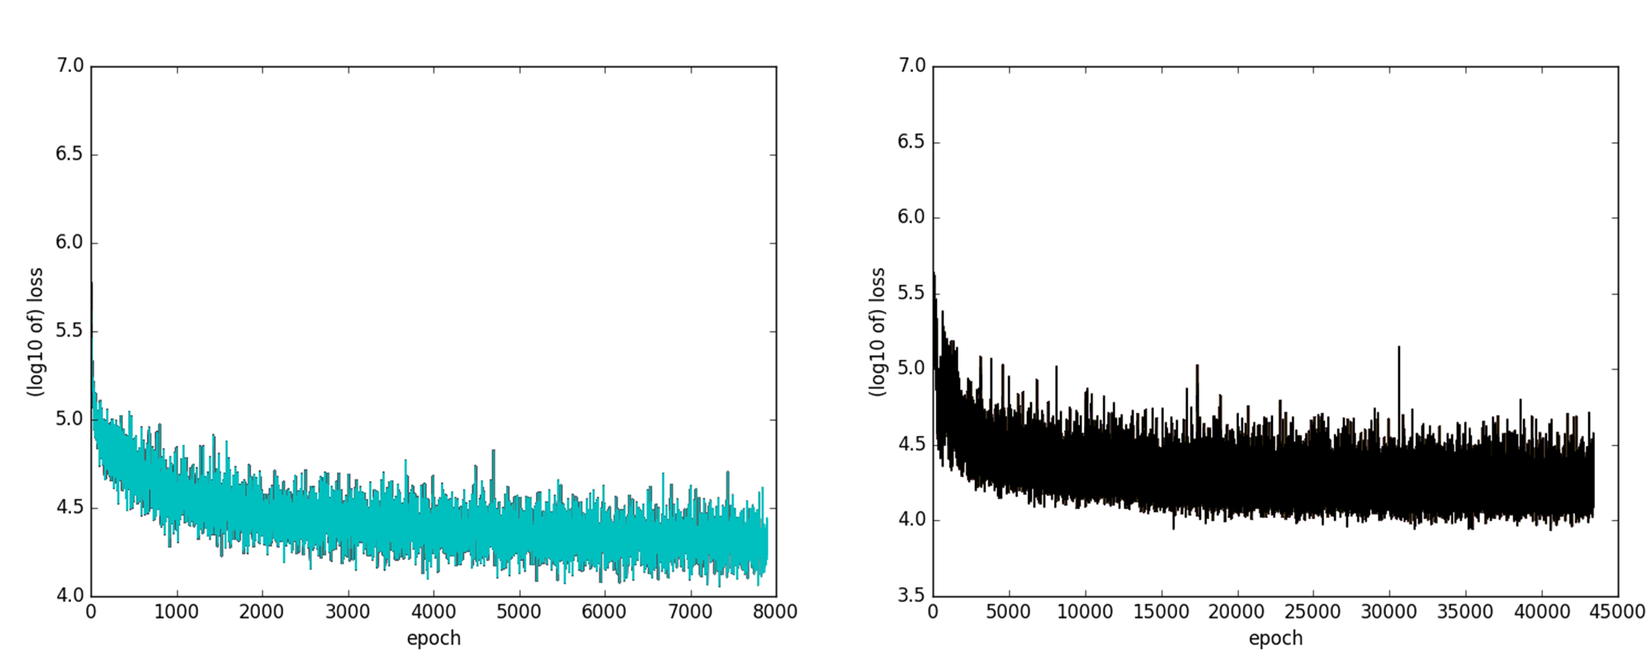

Slide 51
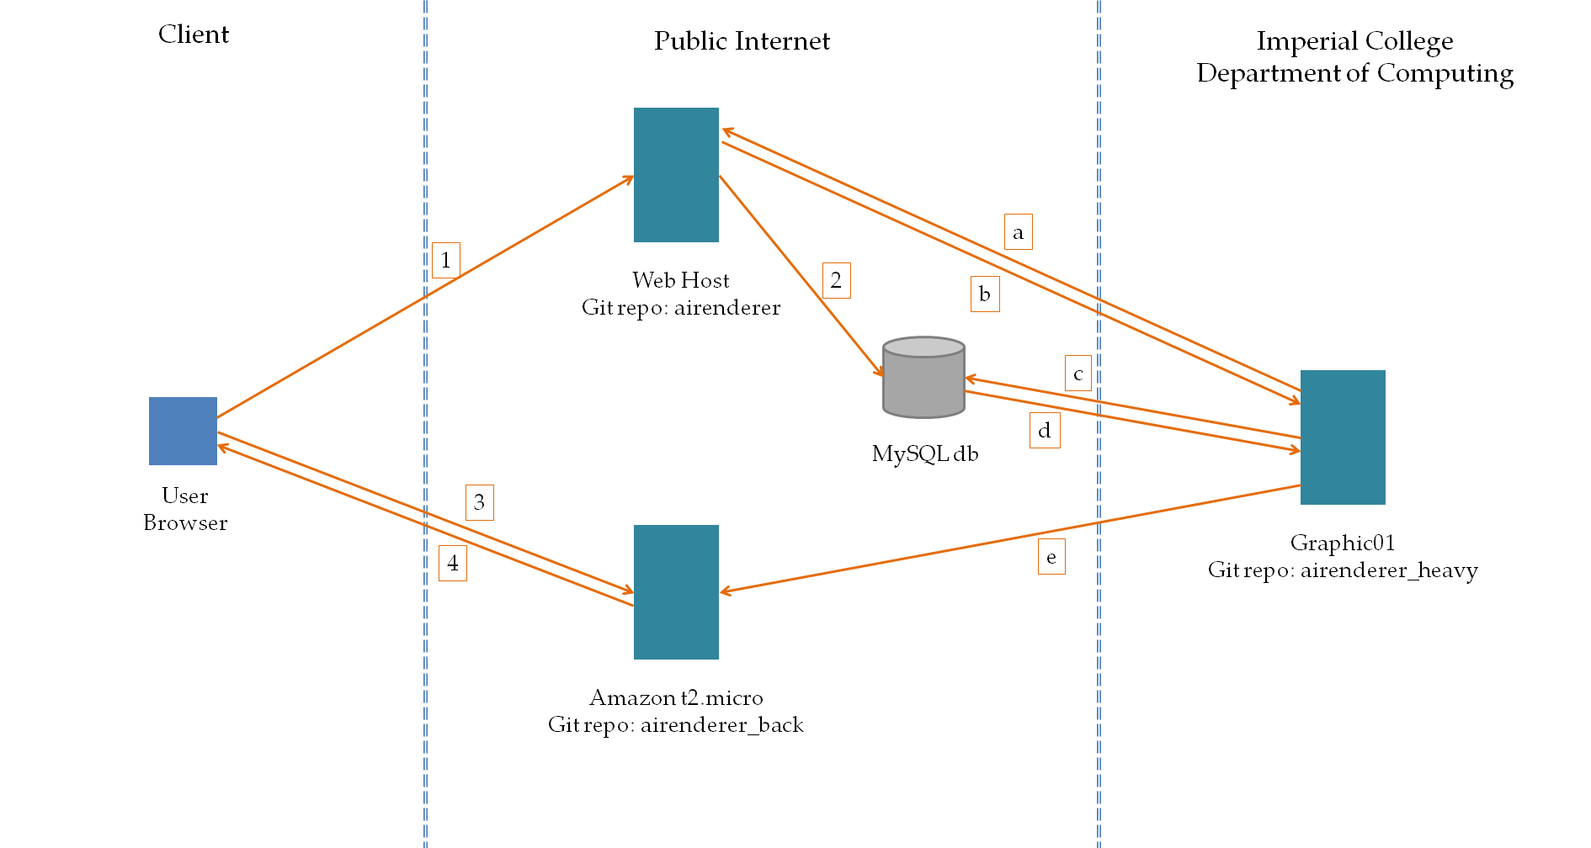

Slide 52
